Slide 1
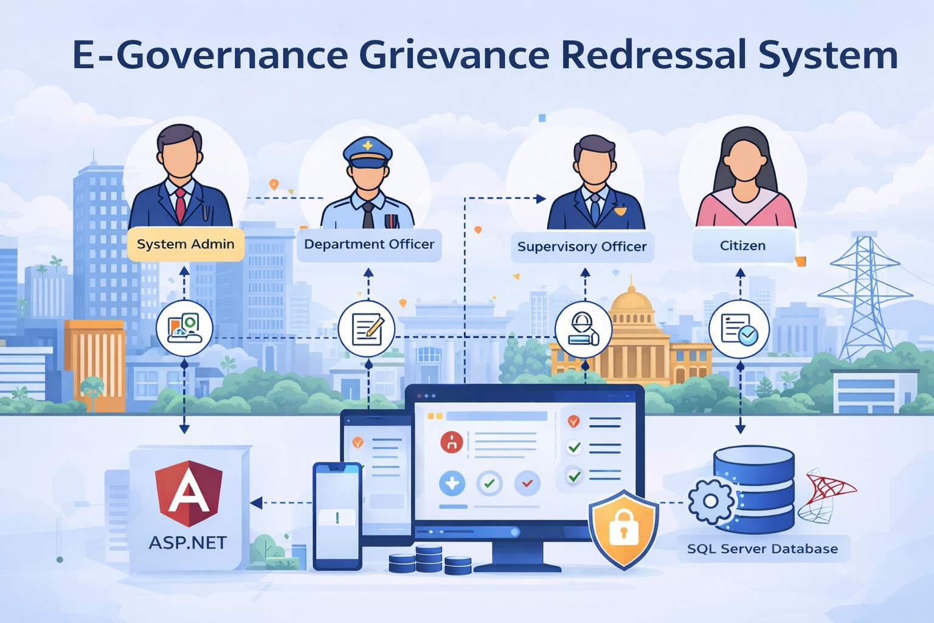
E-Governance Grievance Redressal System
A secure, scalable e-governance platform designed to streamline citizen grievance filing and automate departmental resolution workflows using ASP.NET Core and Angular.
Author: D Pruthvi Reddy

Slide 2
Project Overview
Objective: To design and develop a secure, centralized E-Governance platform that enables citizens to submit, track, and resolve grievances across various government departments efficiently.
Technology Stack: ASP.NET Core (Backend), Angular (Frontend), and SQL Server (Database).
Duration: Ten Days.
Problem Statement: Manual grievance handling leads to a lack of transparency, delayed response times, poor accountability, and no centralized tracking system for public service complaints.

Slide 3
Problem Statement
The government currently lacks a centralized, transparent system for managing public service complaints, leading to inefficiencies and a lack of accountability in grievance handling
Manual Handling Inefficiency: Many grievances are currently processed manually or via email, resulting in delayed responses and unresolved complaints.
Lack of Transparency: There is no centralized system for citizens to track their grievance status in real-time.
Accountability Gaps: Poor accountability across departments makes it difficult to monitor service quality and resolution timelines.
Data Silos: A lack of centralized reporting prevents authorities from accessing analytics on department performance and resolution efficiency.

Slide 4
Solution & Key Features
Grievance Lifecycle Management
End-to-end tracking of complaints through stages: Submitted, Assigned, In Review, Resolved, and Closed.
Smart Dashboards
Role-specific views for Citizens to lodge complaints and Officers to manage their workload effectively.
Secure Access
Multi-layered security using JWT and Role-Based Access Control (RBAC) to protect sensitive citizen data.
Data-Driven Insights
Comprehensive reporting on resolution times and department performance using LINQ-based analytics.

Slide 5
Technology Stack
🎯 Backend
Developed using ASP.NET Core Web API (v8/9) utilizing a Layered Architecture (Controller, Service, Repository) for maintainability.
⚡ Frontend
Built with Angular, featuring a modular architecture with Auth Guards, Interceptors, and Reactive Forms for a responsive UI.
📊 Database
SQL Server managed via Entity Framework Core, storing relational data for Users, Grievances, and Departments.

Slide 6
User Roles
System Admin
Manage departments, officers, categories, and users
Department Officer
View and resolve assigned grievances
Supervisory Officer
Assign grievances, monitor grievances and close grievances
Citizen
Register, submit grievances, and track status and escalate grievance if not resolved within time

Slide 7
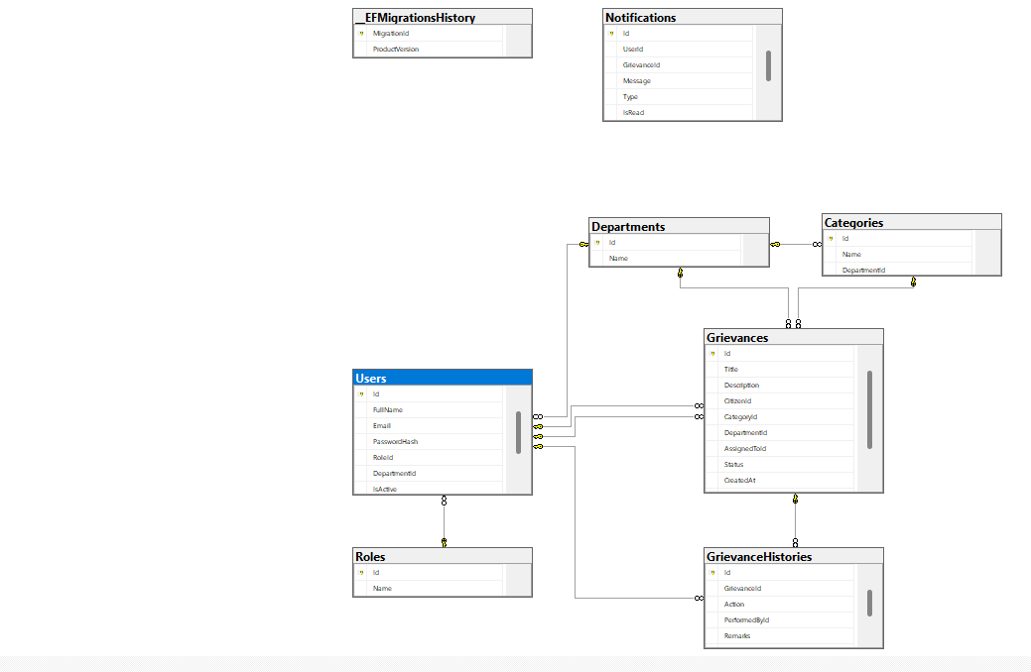
Database Schema Diagram

Slide 8
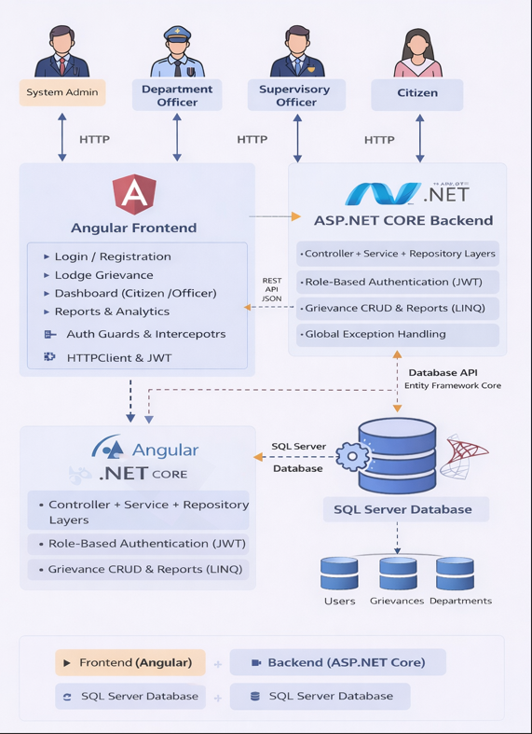
System Architecture
System Architecture Diagram

Slide 9
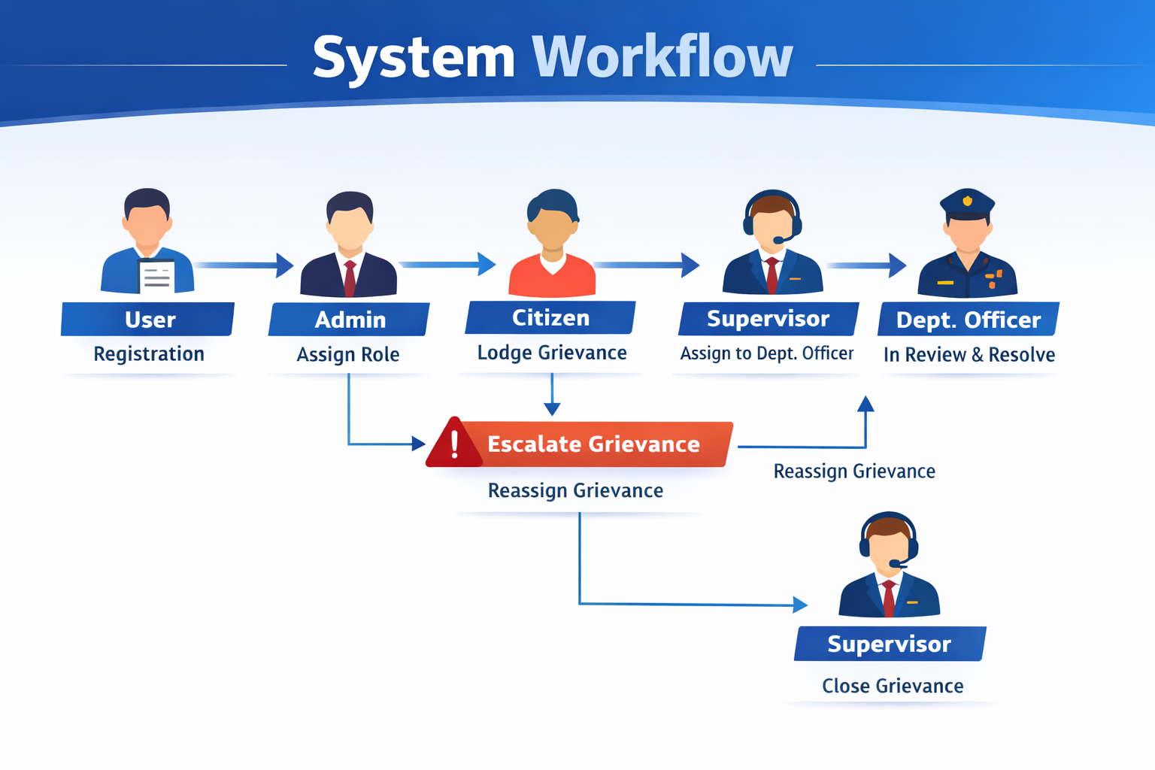

Slide 10
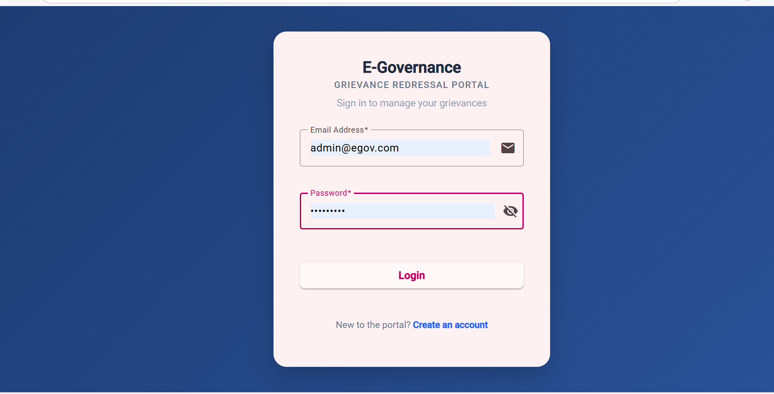
Login Page(UI)

Slide 11
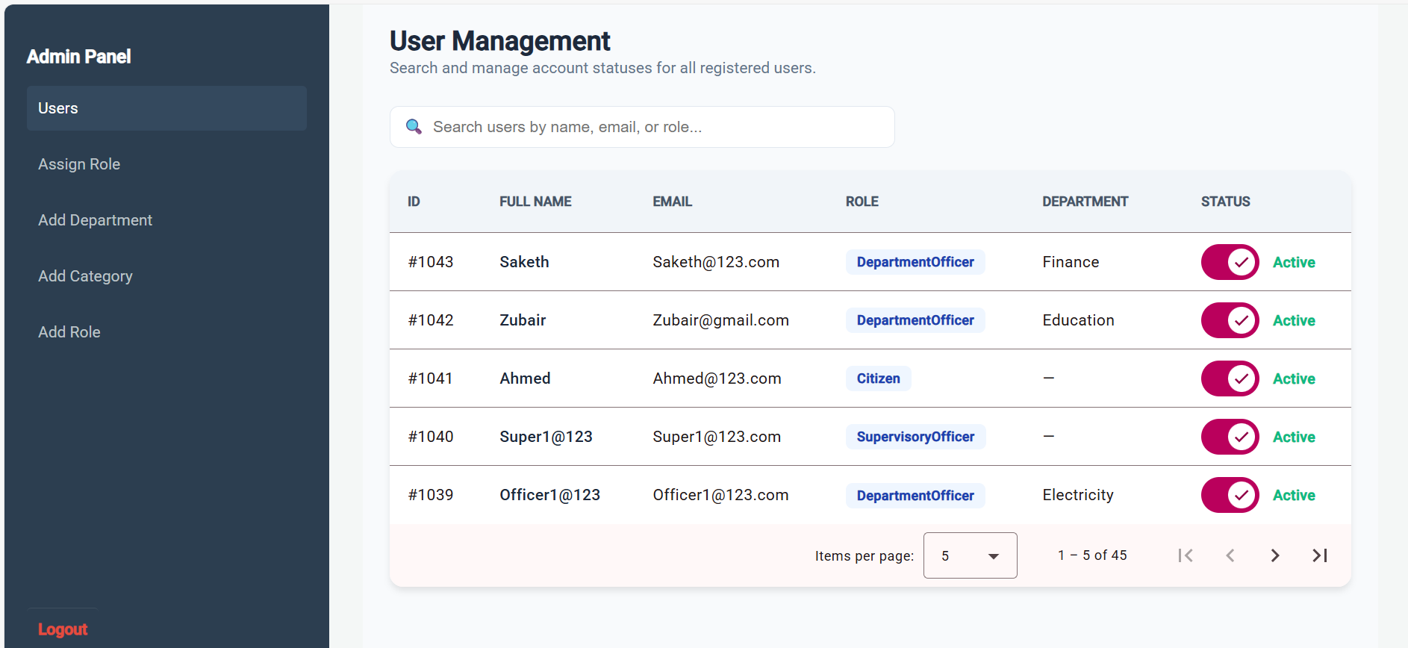
Admin Dashoboard

Slide 12
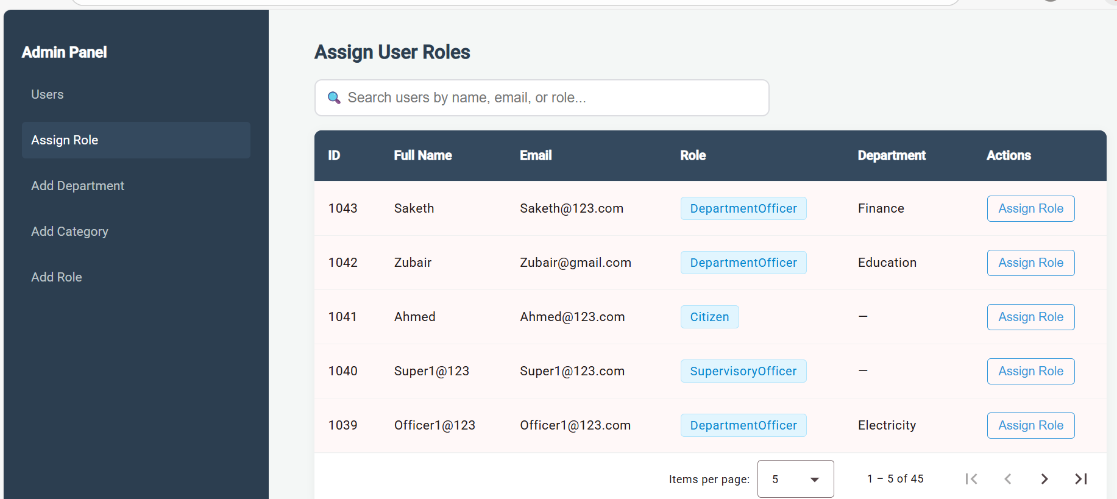
Admin Dashboard/Assign Role Page

Slide 13
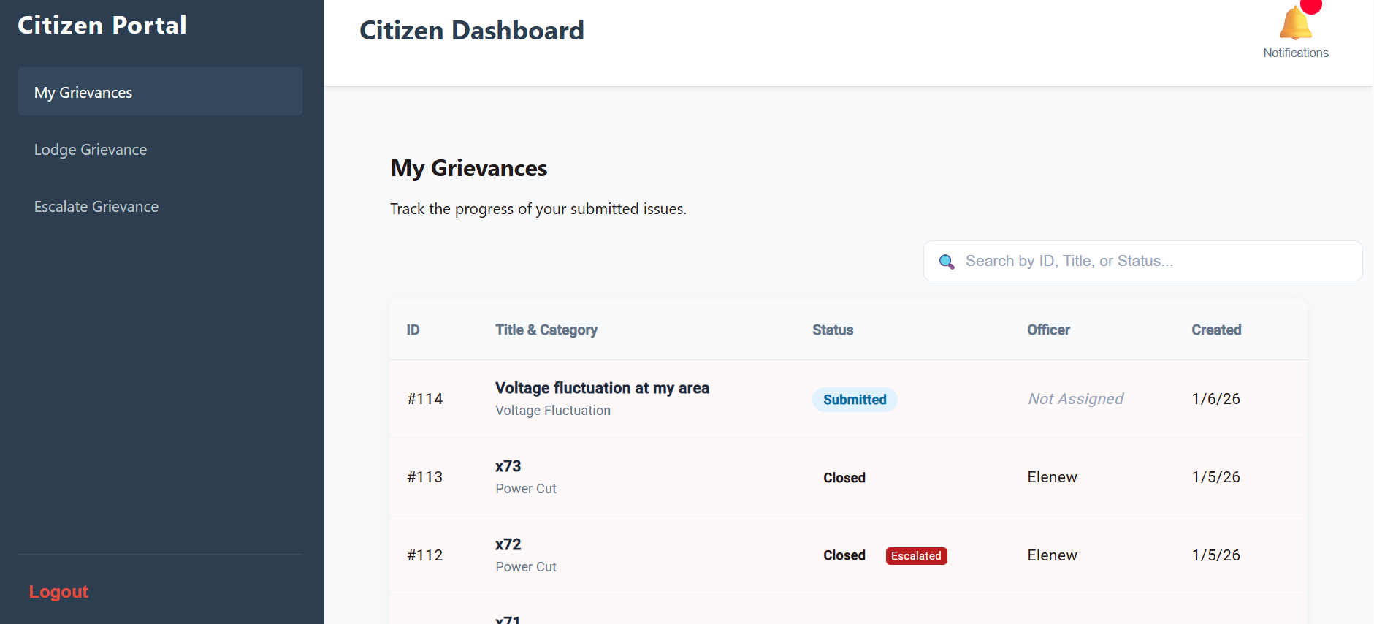
Citizen Dashboard/My Grievances Page

Slide 14
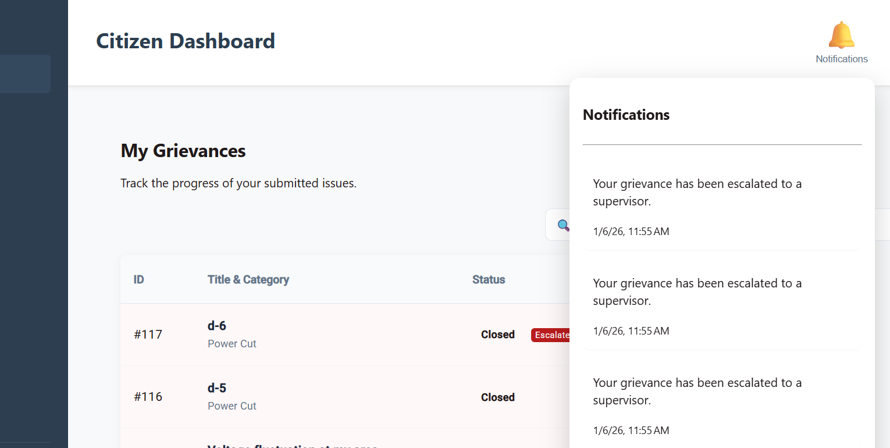
Notifications For Citizen

Slide 15
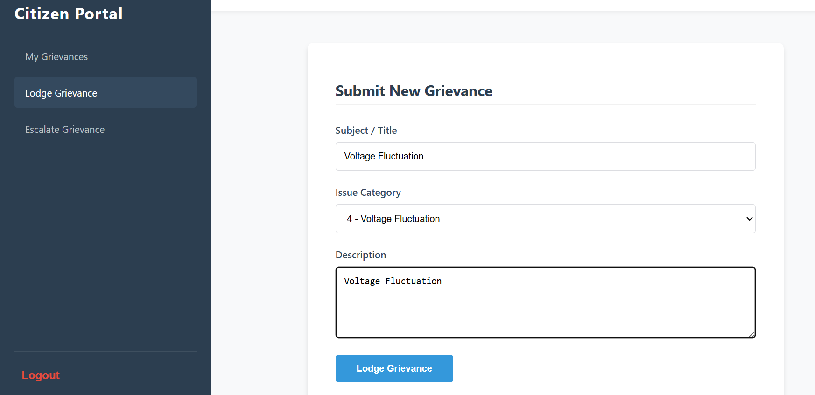
Citizen Dashboard/Lodge Grievance Page

Slide 16
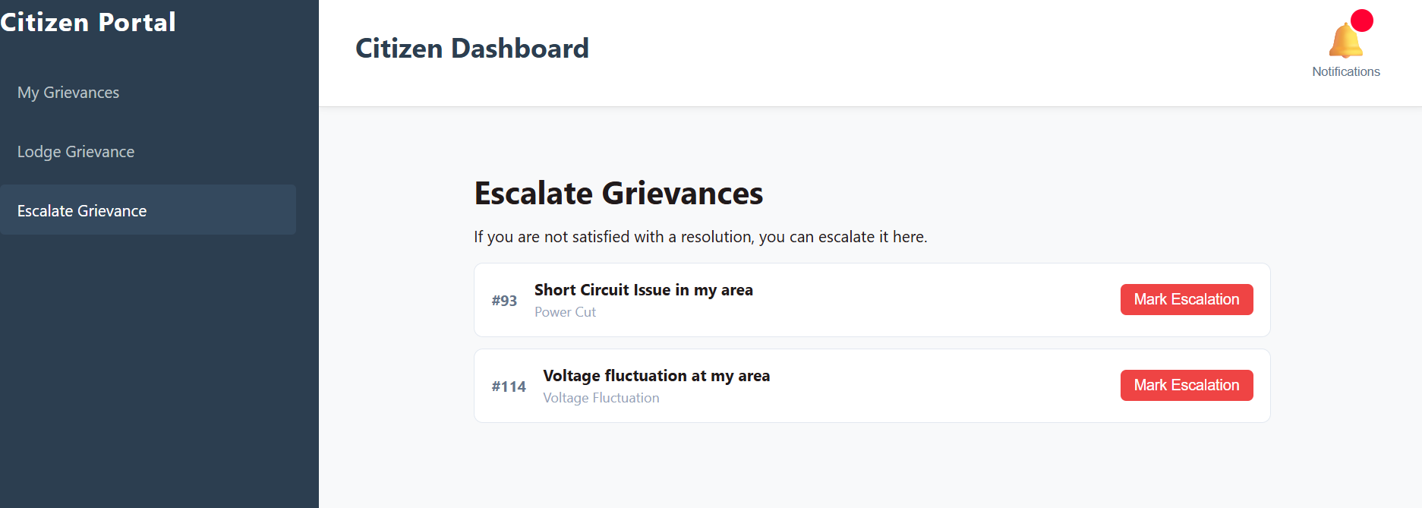
Citizen Dashboard/Escalate Grievance

Slide 17
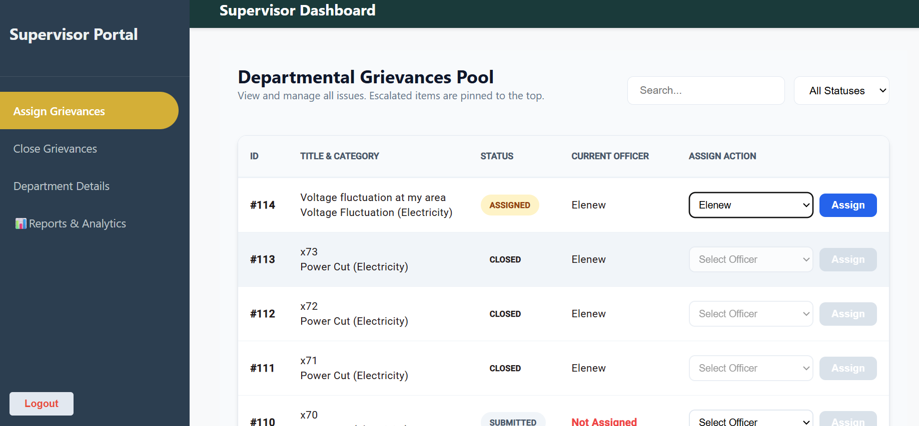
Supervisor-Dashboard/Assign Grievances Page

Slide 18
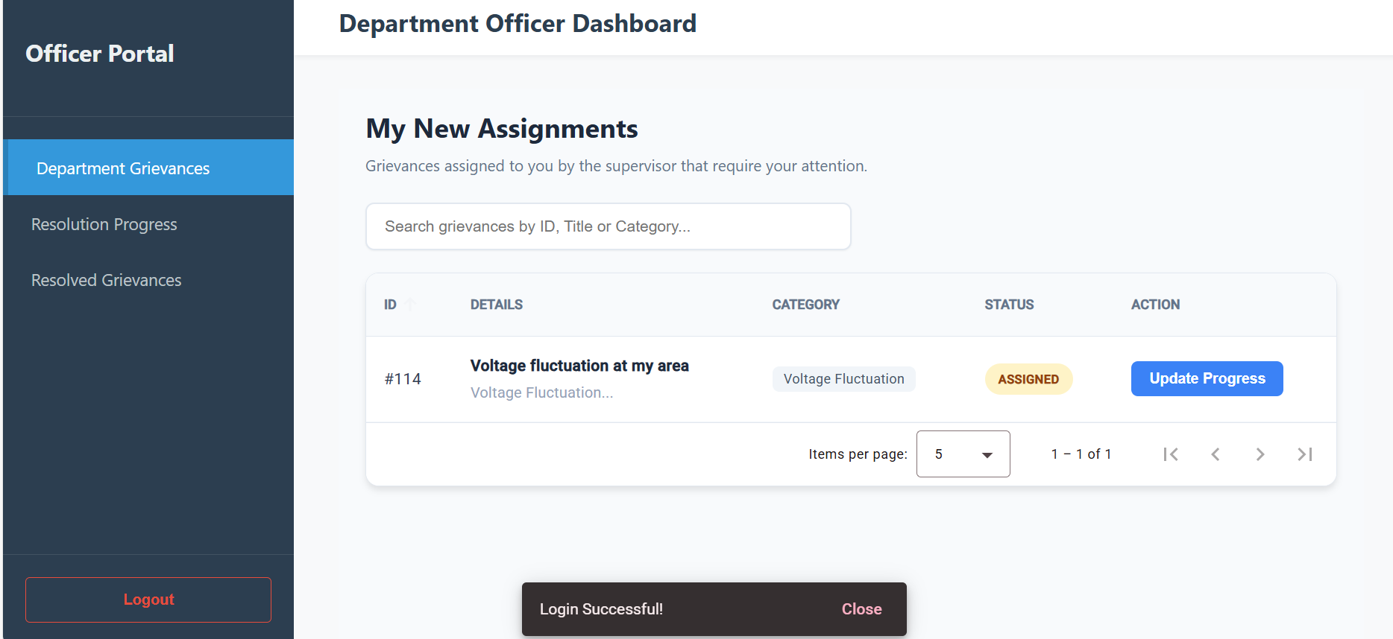
Department-Officer Dashboard/Department Grievances Page

Slide 19
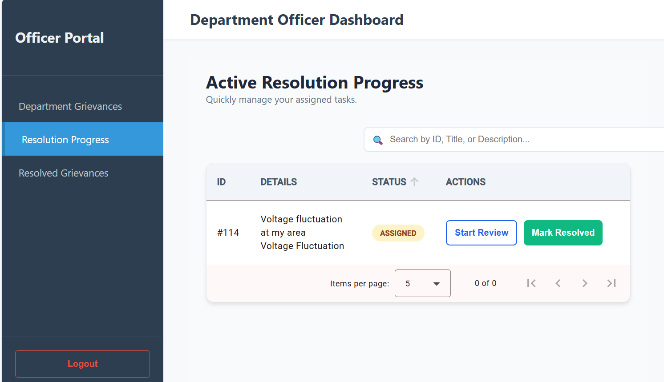
Department-Officer Dashboard/Resolution Progress Page

Slide 20
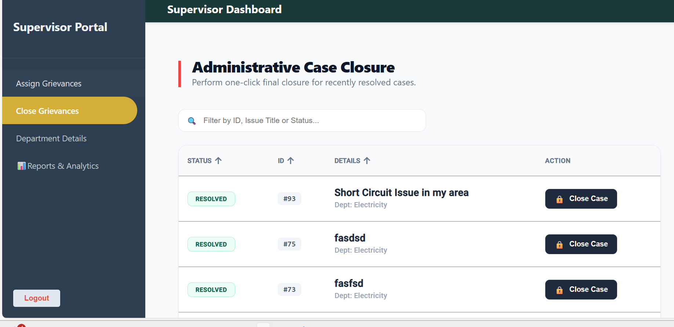
Supervisor-Dashboard/Close Grievances Page

Slide 21
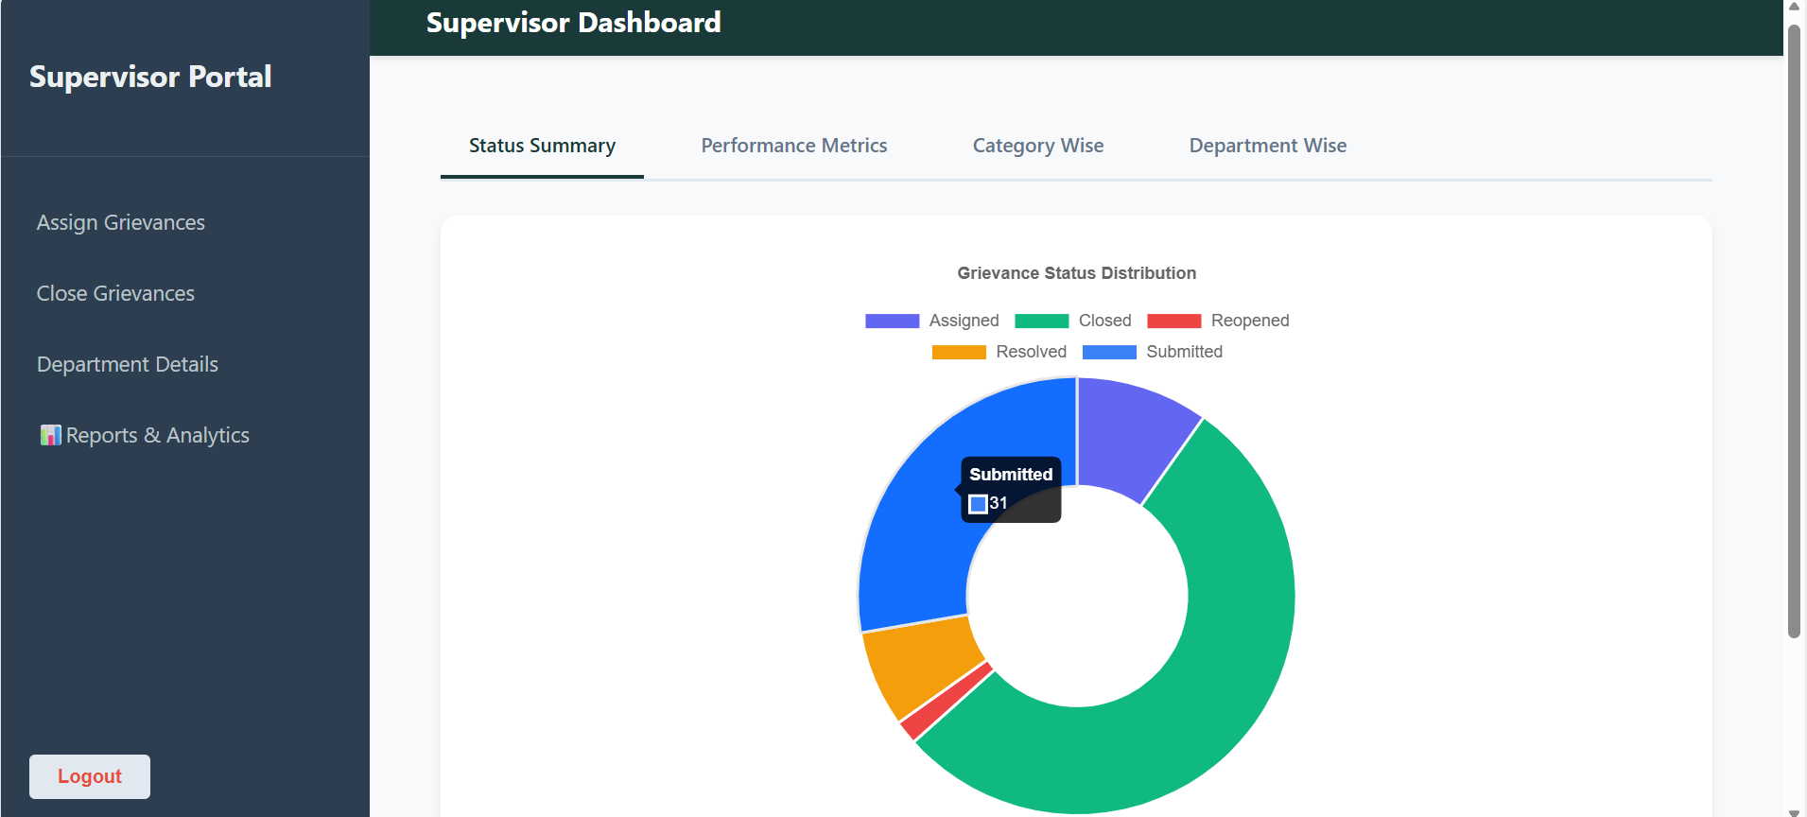
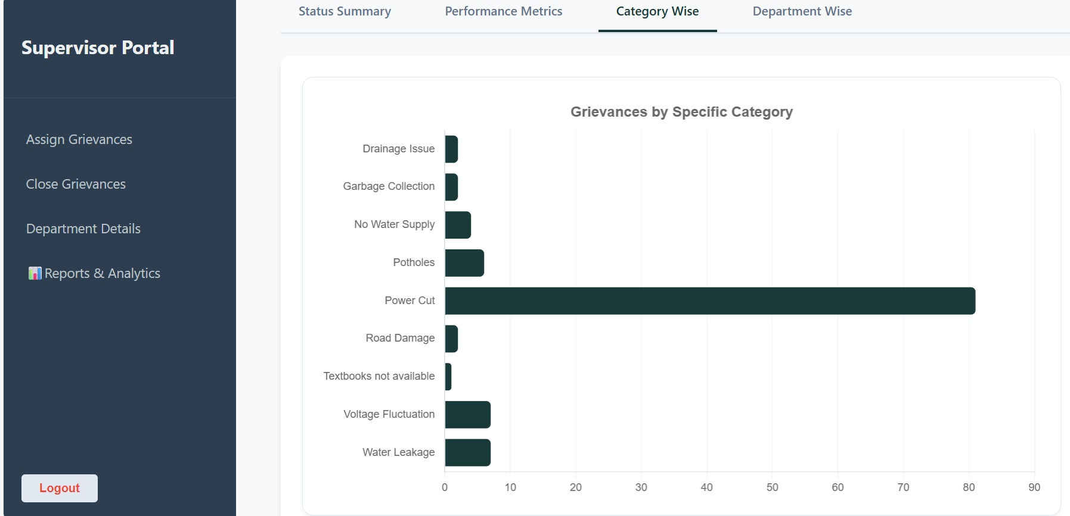
Supervisor-Dashboard/Reports & Analytics Page

Slide 22
Results & Achievements
Bulletproof Authentication: Implemented a secure JWT-based authentication flow with HTTP interceptors to automatically attach bearer tokens to all outgoing requests.
Role-Based Data Isolation: Ensured 100% data privacy by implementing server-side role checks, preventing unauthorized access to sensitive departmental records.
Workflow Automation: Developed a complete grievance lifecycle (Submitted → Resolved → Closed) that automatically routes complaints based on departmental categories.
Efficient Data Retrieval: Leveraged LINQ projection and filtering to ensure that complex reports (like department-wise performance) are calculated directly on the database server rather than in-memory.

Slide 23
Live Demonstration
Live Demonstration
See the application in action
▶️

